Slide 1
Budweiser IPA Study
Brian Tobin and Saqib Shahzad

Slide 2
IPA and Ale Case Study
The study was to determine if Budweiser should invest in the IPA and Ale beer market
The study shows that the IPA and Ale beer market is worth investing for Budweiser
The following slides will show which States Budweiser may have the best market penetration

Slide 3
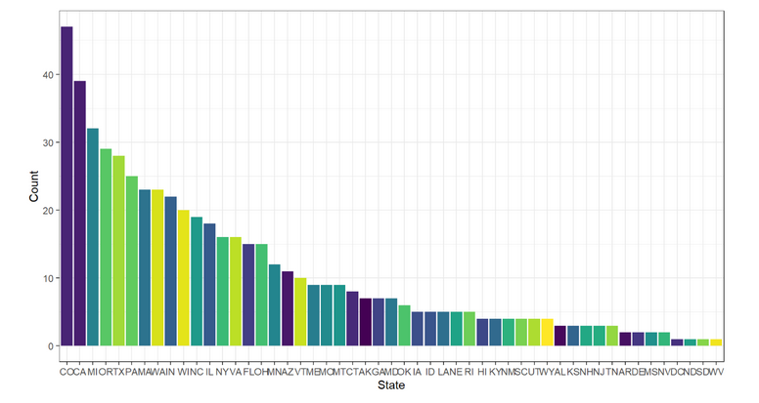
Number of Breweries By State

Slide 4

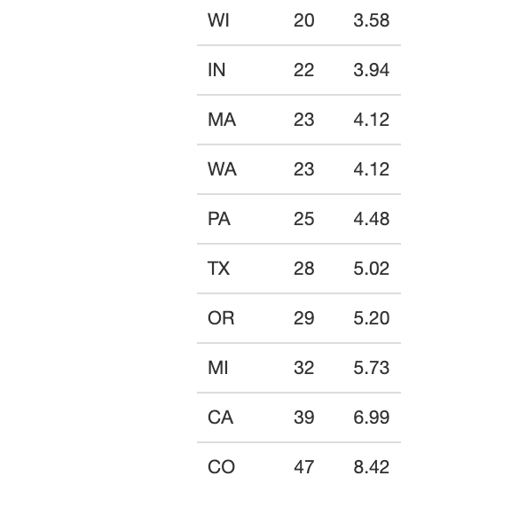
Top 10 States:

Slide 5
Maximum Alcoholic (ABV) VS Most Bitter (IBU) beer
First six
Beer_ID Beers Brewery_id Breweries ABV IBU Style Ounces City State
1436 Pub Beer 409 10 Barrel Brewing Company 0.05 NA American Pale Lager 12 Bend OR
2265 Devilâs Cup 178 18th Street Brewery 0.07 NA American Pale Ale (APA) 12 Gary IN
2264 Rise of the Phoenix 178 18th Street Brewery 0.07 NA American IPA 12 Gary IN
2263 Sinister 178 18th Street Brewery 0.09 NA American Double / Imperial IPA 12 Gary IN
2262 Sex and Candy 178 18th Street Brewery 0.08 NA American IPA 12 Gary IN
2261 Black Exodus 178 18th Street Brewery 0.08 NA Oatmeal Stout 12 Gary IN
Last six
Beer_ID Beers Brewery_id Breweries ABV IBU Style Ounces City State
1035 Rocky Mountain Oyster Stout 425 Wynkoop Brewing Company 0.08 NA American Stout 12 Denver CO
928 Belgorado 425 Wynkoop Brewing Company 0.07 45 Belgian IPA 12 Denver CO
807 Rail Yard Ale 425 Wynkoop Brewing Company 0.05 NA American Amber / Red Ale 12 Denver CO
620 B3K Black Lager 425 Wynkoop Brewing Company 0.06 NA Schwarzbier 12 Denver CO
145 Silverback Pale Ale 425 Wynkoop Brewing Company 0.06 40 American Pale Ale (APA) 12 Denver CO
84 Rail Yard Ale (2009) 425 Wynkoop Brewing Company 0.05 NA American Amber / Red Ale 12 Denver CO
Maximum Alcoholic and Bitterness
Two breweries have the highest Alcohol and Bitterness content
One brewery has the lowest Alcohol and Bitterness content

Slide 6
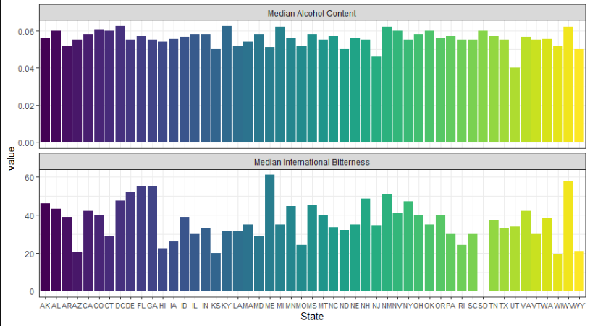
Median Alcohol and Bitterness Per State
Median of Alcohol and Bitterness
The median range for alcohol is about .05 percent
The median range for bitterness varies per state but ranges between 20 and 30 percent

Slide 7
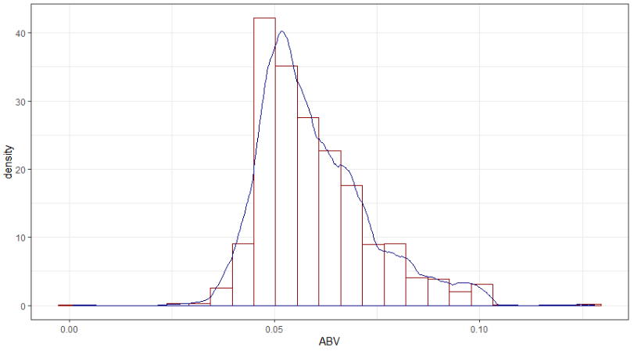
Distribution of Alcohol
Distribution
The highest volume range of alcohol is between .05 and .08
Most IPA and Ale beers fall within this range
There is smaller volumes with higher alcohol content

Slide 8
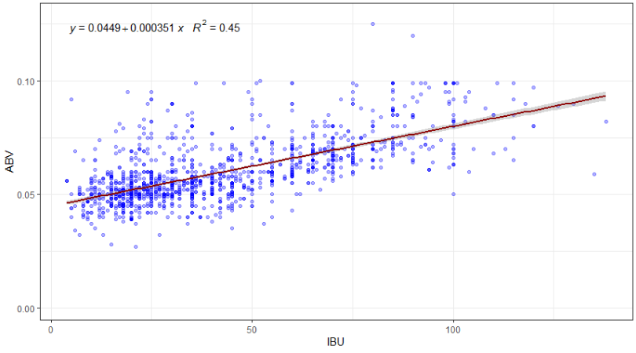
Alcohol and Bitterness Comparison
Comparison
There is proven evidence that ABV rises as IBU becomes more bitter
The most dense are is around the .05 percent alcohol
The second most dense is around the .08 to .10 percent alcohol

Slide 9
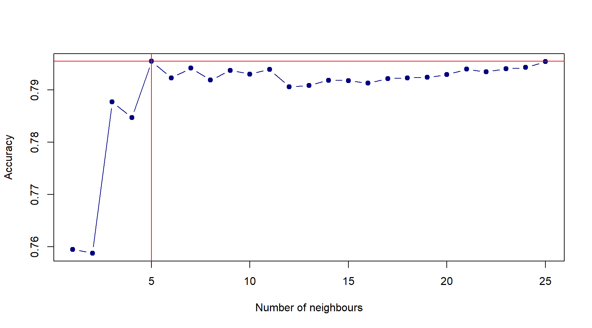
Most Optimal K-Value Test
K-Value Test
Increases accuracy of the model
Utilizes the lowest and most optimal K-Value
Transformed and normalized

Slide 10
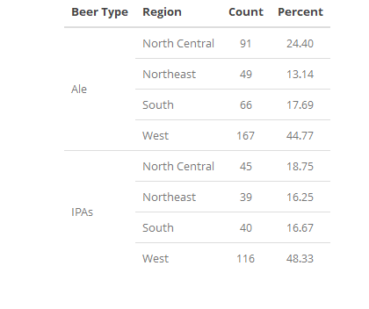
Beer Penetration Per Region
Summary of Region Penetration
West has the highest penetration of Ale and IPA beers
Ale market has the least penetration in the Northeast region
IPA market has the least penetration in the Northeast region
North Central region is nearly the same for IPA and Ale beers

Slide 11
Conclusion
Closing remarks
We believe that the West has the highest penetration of Ale and IPA beers and would not be a market to penetrate
Ale market has the least penetration in the Northeast region and Budweiser would do well to market Ale beers
IPA market has the least penetration in the Northeast region and Budweiser would do well to market IPA beers
North Central region is nearly the same for IPA and Ale beers and Budweiser would do well to market both IPA and Ale beers

Slide 12
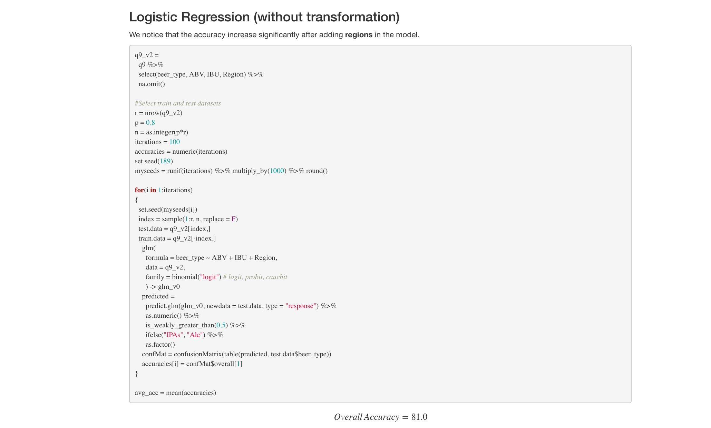
Code Snippet for Future Research

